Slide 1
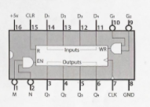
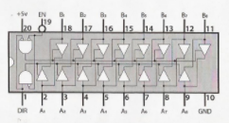
Ben Eater’s 8 Bit Computer
INSTRUCTION REGISTER IC PINOUTS
I
74LS245:
8-bit bus transceiver
I
74LS173:
4-bit D register
74LS173:
4-bit D register

